Slide 1

Computational Physics (PHYS6350)
Lecture 24: Introduction to parallel computing
Instructor: Volodymyr Vovchenko (vvovchenko@uh.edu)
Course materials: https://github.com/vlvovch/PHYS6350-ComputationalPhysics
Online textbook: https://vovchenko.net/computational-physics/

Slide 2
Parallel computing
So far, we’ve dealt with sequential computational workflow
Operations proceed one after another
Limited by the processing speed of the logical processing unit
For instance, CPU clock speeds have not moved much past 3GHz in the past decade
In parallel computing multiple processing units perform tasks simultaneously to solve complex problems more efficiently, thereby dividing the workload among multiple processors
Motivation
Better performance (relieves the clock speed bottleneck)
Resource utilization (use multi-core processors and/or GPUs that are otherwise idle)
Scalability (adaptation to increasing size and complexity of problems)
Time-to-solution (get valuable insight from a complex physical simulation in reasonable time)
Cost-effectiveness

Slide 3
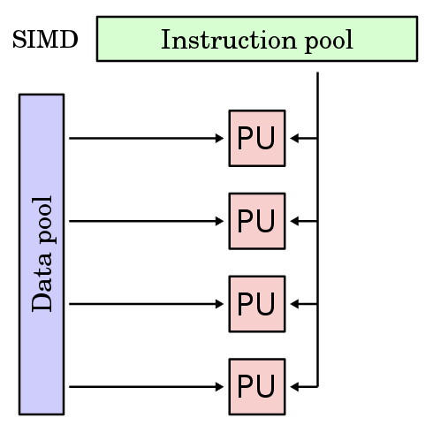
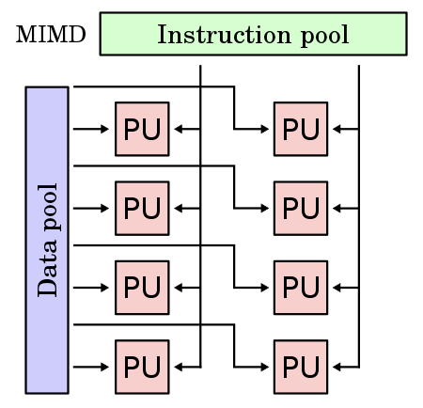
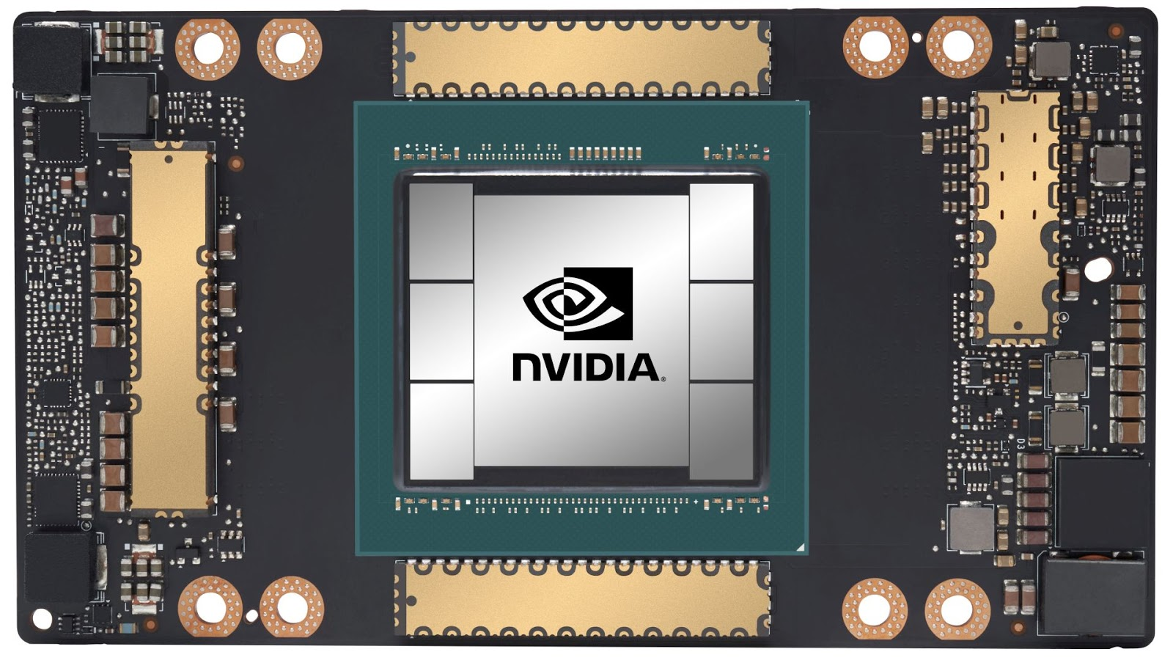




Brief history of parallel computing
1940-1960: Early concepts (von Neumann, IBM,…)
1960-1980: Vector processors, SIMD (single instruction multiple data)
1980-2000: Multi-core architectures, MIMD (multiple instruction multiple data)
1990-…: Clusters and distributed computing
Computer networks
Many individual computers combine to achieve high performance parallel computing
2000-…: GPUs
Originally designed to graphics but have parallel computing potential
Suitable for scientific computing, deep learning, data analysis
2010-…: Parallel computing frameworks and cloud computing
MPI, OpenMP, OpenCL, CUDA…

Slide 4
Types of parallelism
Instruction-Level Parallelism (ILP)
Concurrent execution of multiple instructions within a single processor or core
Many compilers optimize code to take advantage of ILP
Data-Level Parallelism (DLP)
Performing the same operation on multiple data elements simultaneously
Suitable for applications with regular data access patterns
Architectures: Single Instruction Multiple Data (SIMD), Vector Processors, Graphics Processing Units (GPUs)
Examples: Numerical integration, molecular dynamics step, matrix operations
Task-Level Parallelism (TLP)
Concurrent execution of multiple, independent tasks or threads within a program
Suitable for applications with irregular data access patterns or complex control flow
Programming models: OpenMP (shared-memory), MPI (distributed-memory), CUDA/OpenCL (GPU computing)
Examples: Markov Chain Monte Carlo
In practice different types of parallelism are combined together

Slide 5
Parallel Computing Architectures
Shared Memory Systems
Multiple processors or cores share a common memory space
Communication through memory, no need for explicit message passing
Programming models: OpenMP, threads
Distributed Memory Systems
Multiple processors or cores, each with its own private memory
Communication through message passing between processors
Examples: Clusters, Supercomputers, High-Performance Computing (HPC) systems
Programming models: Message Passing Interface (MPI)
Hybrid Systems
Combination of shared memory and distributed memory architectures
E.g. CPU-GPU systems
Programming models: OpenMP (shared-memory), MPI (distributed-memory), CUDA/OpenCL (GPU computing)
Programming models: OpenMP + MPI, OpenCL/CUDA

Slide 6

Programming Models for Parallel Computing
Shared Memory Models
OpenMP (Open Multi-Processing)
Compiler directives and runtime library for shared-memory parallelism (C/C++/Fortran)
Threads
Executing parallel code in threads with control over synchronization (C/C++)
Distributed Memory Models
MPI (Message Passing Interface) library
Communication and synchronization between processes in distributed-memory systems
GPU Computing
NVIDIA CUDA (Compute Unified Device Architecture)
Data-parallel programming with GPU-specific language extensions and libraries (C/C++)
OpenCL (Open Computing Language)
Open standard for parallel programming of heterogeneous systems (CPUs, GPUs, FPGAs), (C/C++)

Slide 7
Performance metrics
Speed-up and efficiency
Ratio of the execution time of a serial program to the execution time of its parallel counterpart
Ideally: computational time reduced linearly with number of processing elemens (e.g. CPUs)
Efficiency is the ratio of speedup to the number of processing elements
Scalability
Ability to maintain performance with the increase of
number of processing elements
problem size
Load balancing
Even distribution of work across processing elements and minimization of idle time
Overhead
Limitation of performance fue to data exchange and coordination between processing elements

Slide 8
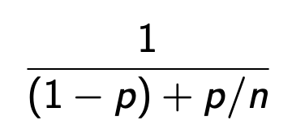
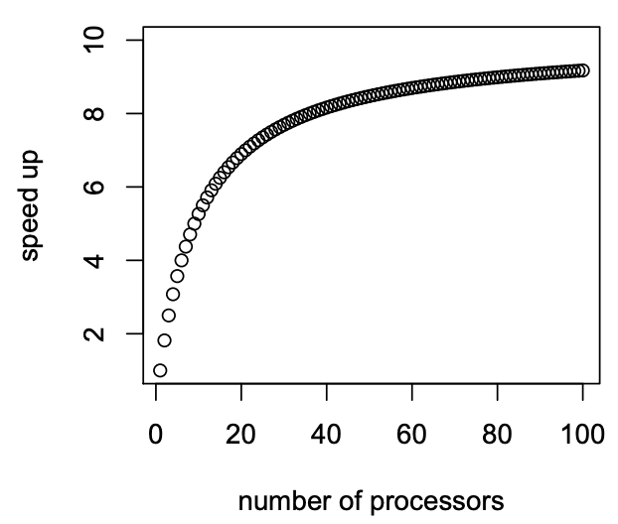
Amdahl’s Law
In practice only fraction p of the problem can be parallelized
Amdahl’s Law: theoretical speed-up as a function of processing elements n and p
Example: p = 90%
S =
no infinite speed-up possible
Gustafson’s Law: Linear speed-up with n if problem size also increases
If the problem is small, parallel computing does not give much advantage

Slide 9
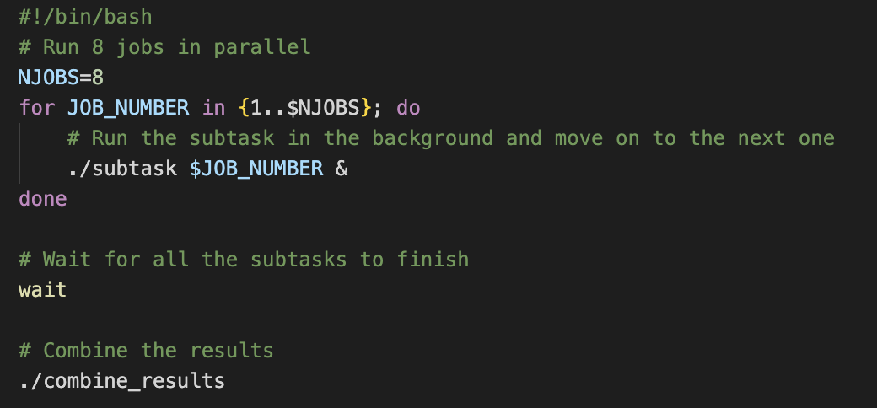
Embarrassingly Parallel Computations
Task can be divided into parts that can be executed separatedly
Examples:
Numerical integration
Split the integration region into many parts, computed them concurrently, and combine the results
Monte Carlo simulations (generating events in parallel)
Generate random samples (events) in parallel using different random seed, then combine the statistics
Matrix operations
E.g. matrix multiplication where each element can be computed concurrently
Sample workflow:

Slide 10
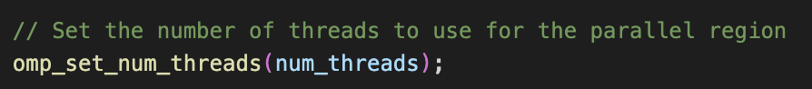
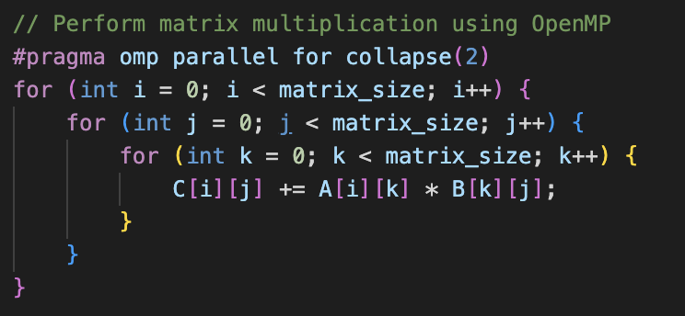
Example: Matrix Multiplication
In matrix multiplication, C = A*B, each element of C_{i,j} can be computed independently of all other elements
matrix_mult_openmp.cpp:
…

Slide 11
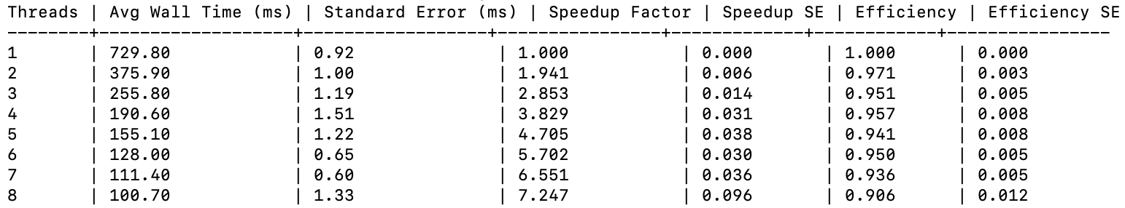
Example: Matrix Multiplication
In matrix multiplication, C = A*B, each element of C_{i,j} can be computed independently of all other elements
matrix_mult_openmp.cpp:
Example: Multiplying 1000x1000 matrices
…
1 thread:
8 threads:
Study the performance (here 500x500):

Slide 12
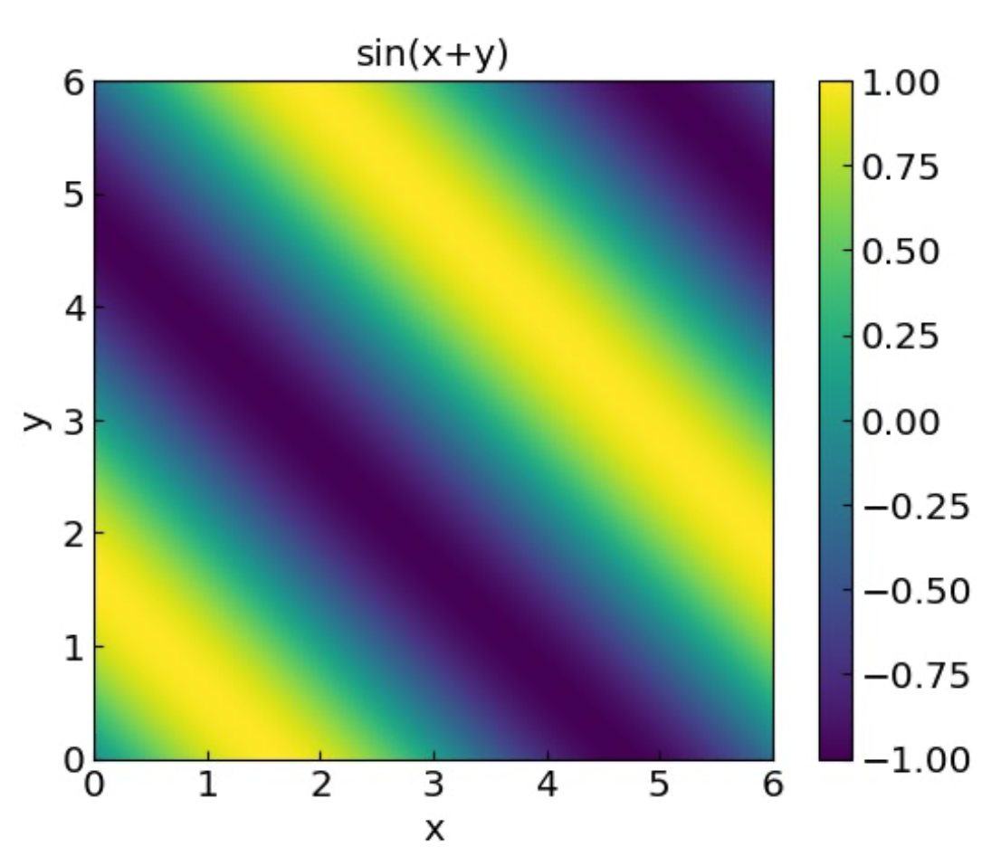
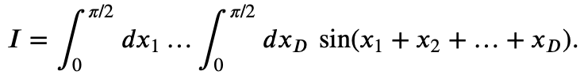
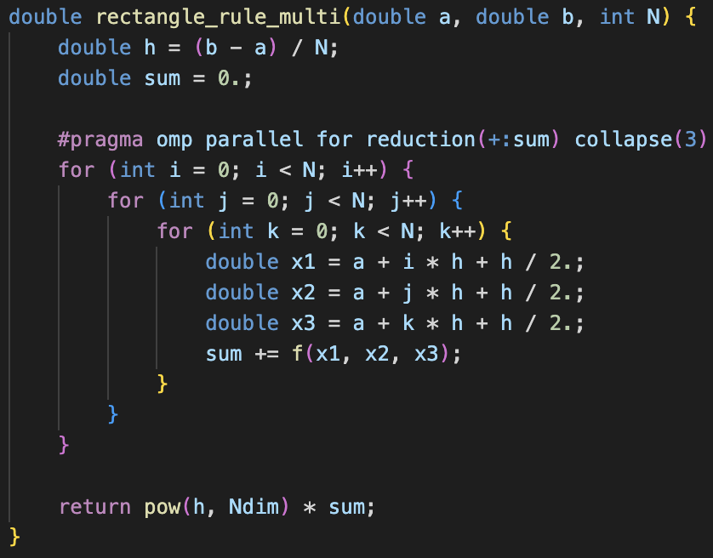
Example: Multi-dimensional numerical integration
Recall the integral:
Use rectangle rule and OpenMP to compute in 3D
rectanglerule_multi_openmp.cpp
Example: Use 1000 slices in each dimension
1 thread:
8 threads:

Slide 13
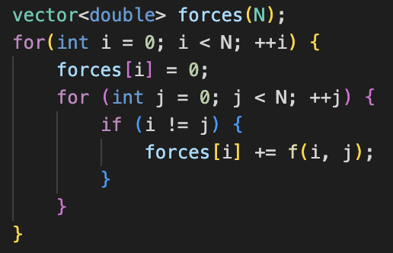
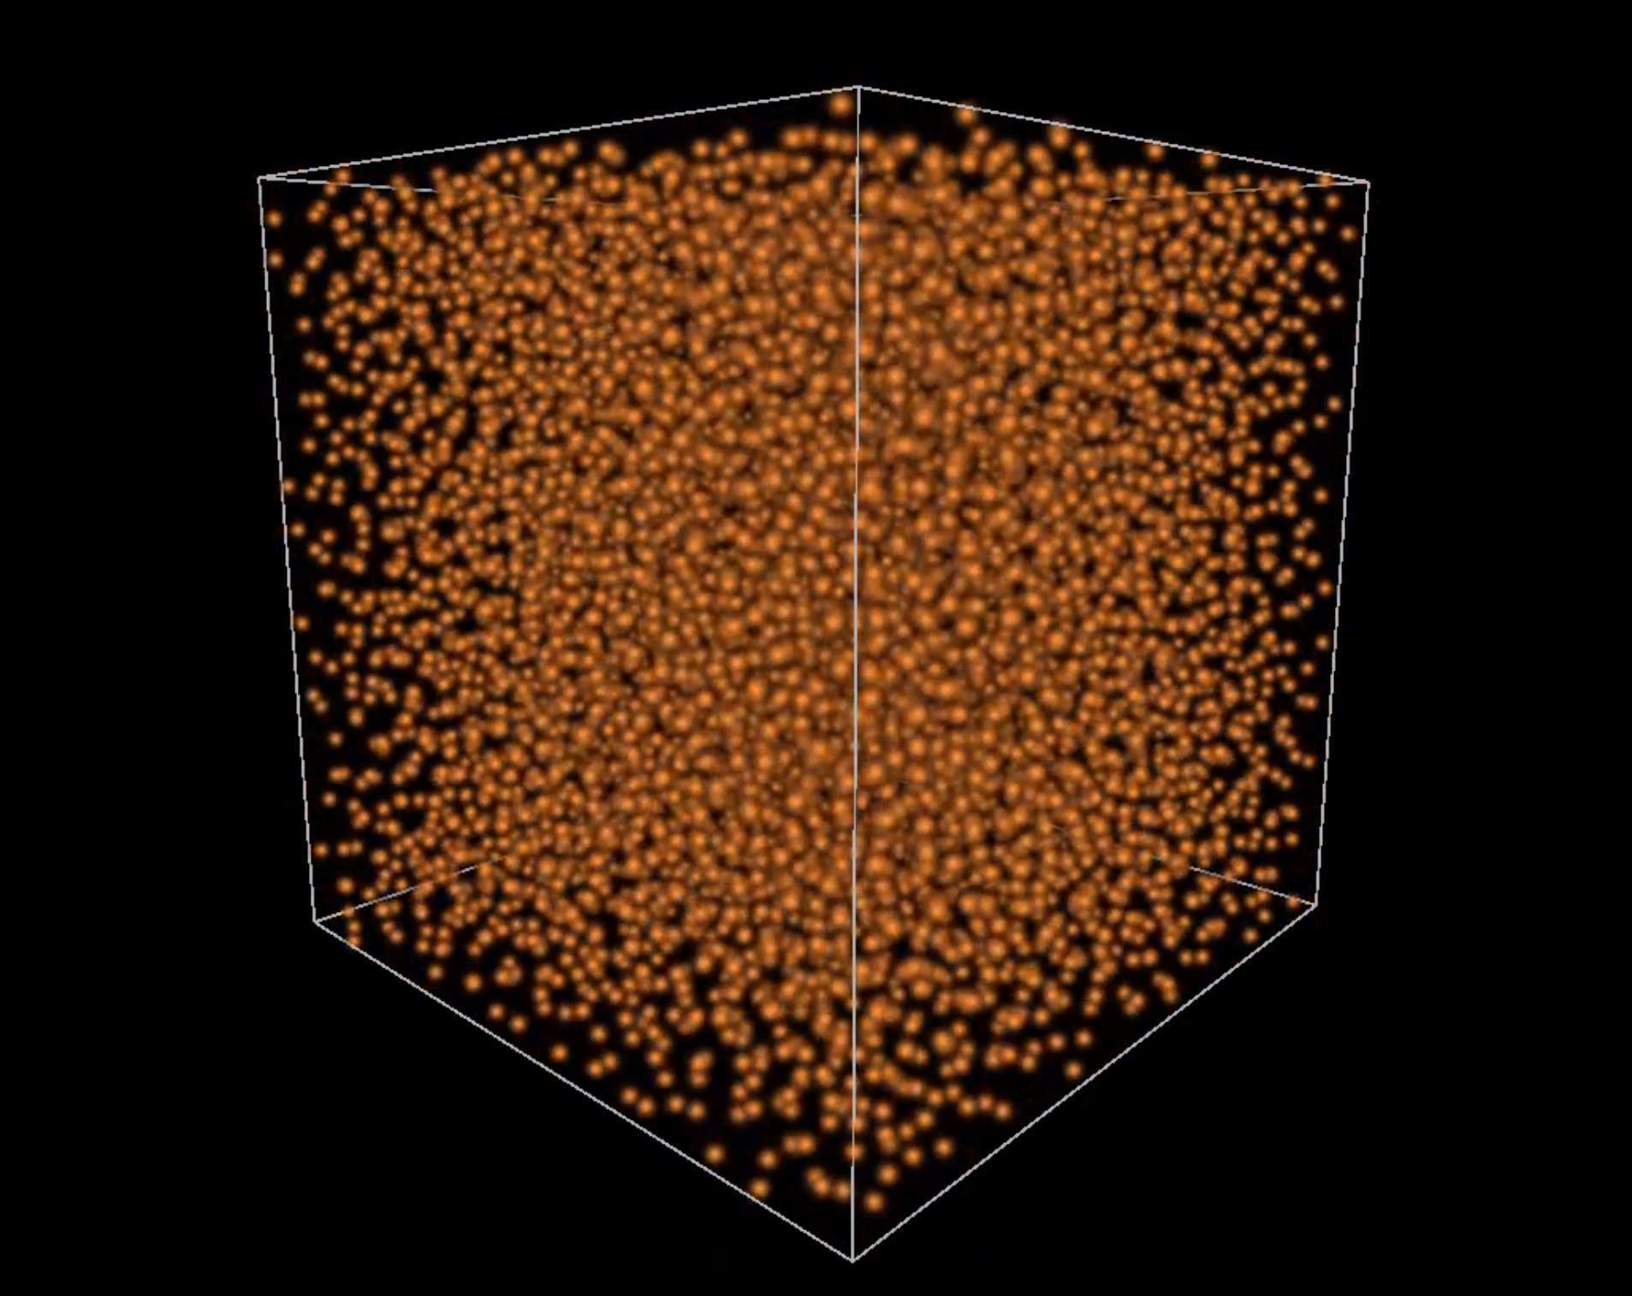

Example: Lennard-Jones molecular dynamics on NVIDIA CUDA
Classical Molecular Dynamics and N-body problem
Each step of ODE integration involves computing all the forces
O(N²) complexity
Makes simulation of large systems expensive
Parallel algorithm:
Each force can be computed independently of other forces
Ideally suited for GPUs (large number of parallel threads)
Things to keep in mind:
Need to move data between global and local GPU memory
Threads need to be synchronized each integration step
Implementation on CUDA for Lennard-Jones fluid:
open source: https://github.com/vlvovch/lennard-jones-cuda
see also: https://developer.nvidia.com/cuda-code-samples

